Slide 1
TB Groups, Each vs Each

Slide 2
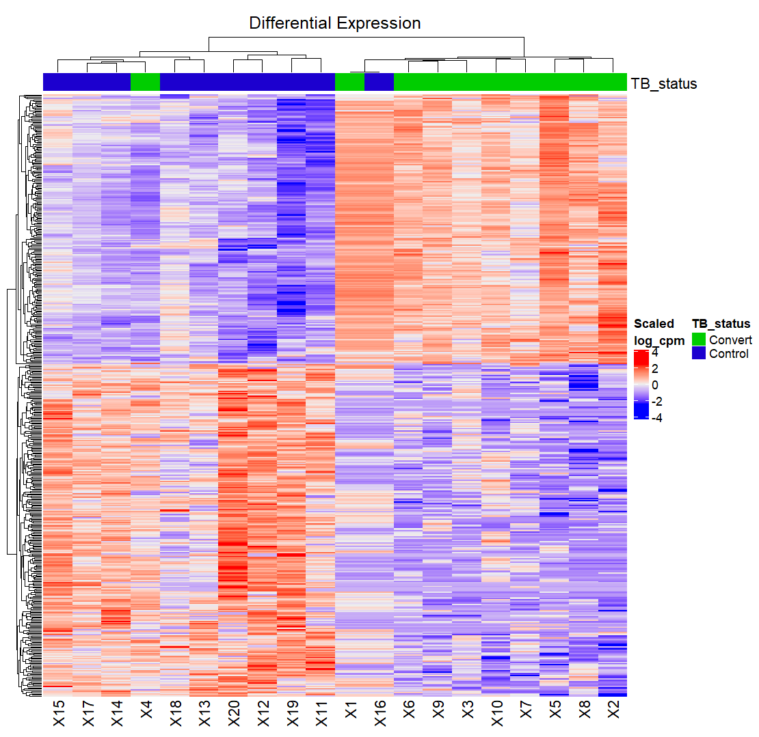
Control vs Converter
Apparently no significant genes between the two groups with p-adjusted values

Slide 3
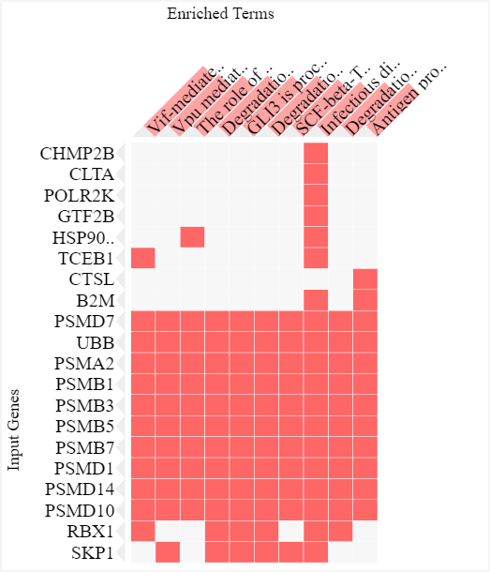
Control vs Latent

Slide 4
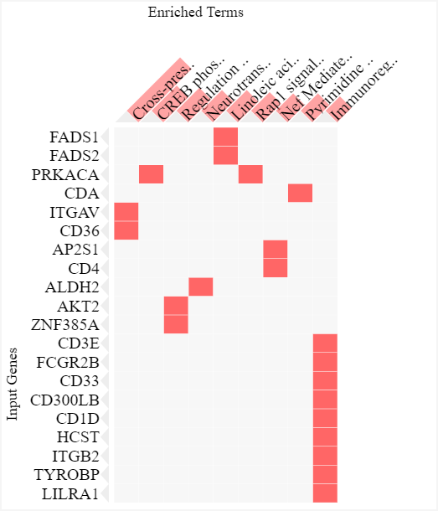
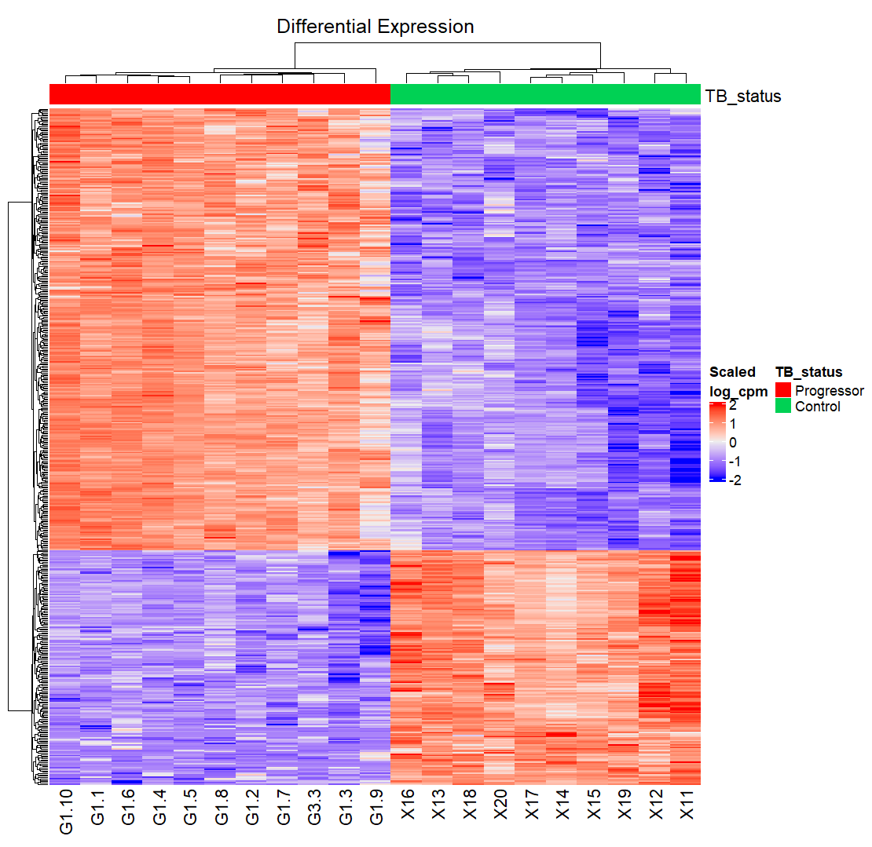
Control vs Progressor

Slide 5
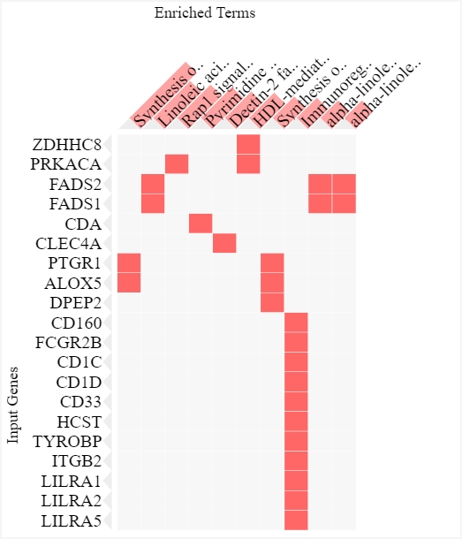
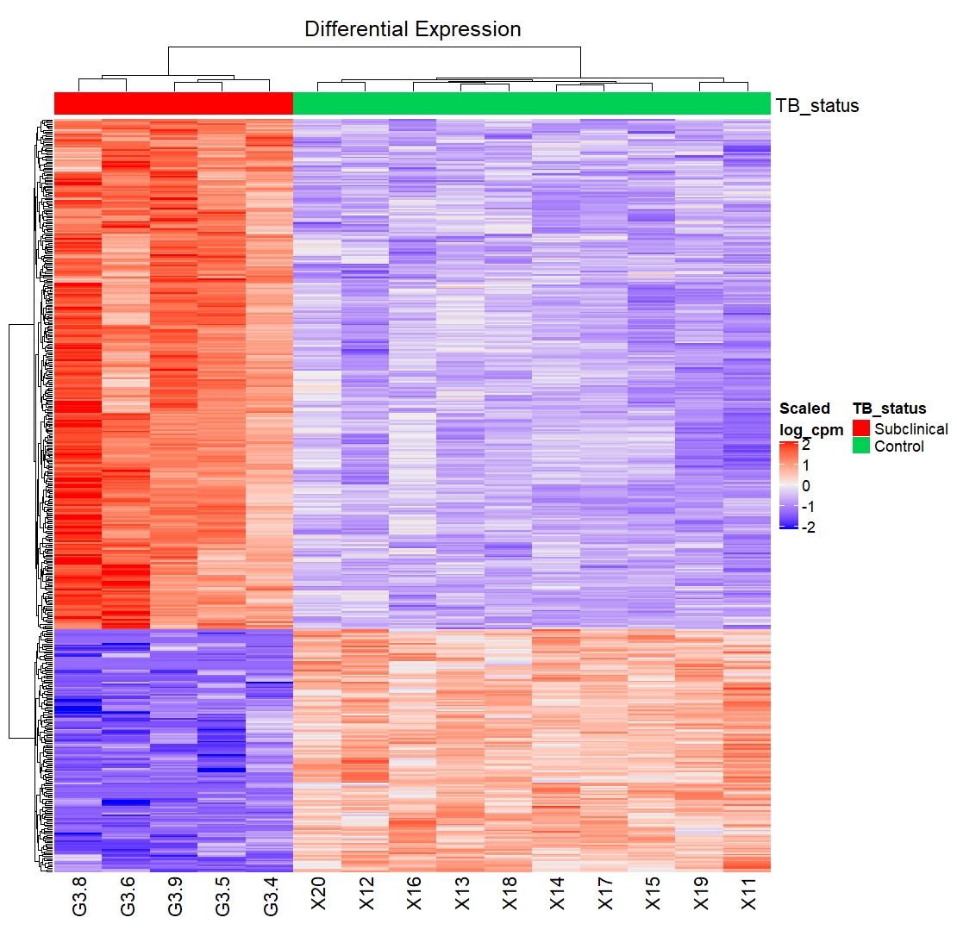
Control vs Subclinical

Slide 6
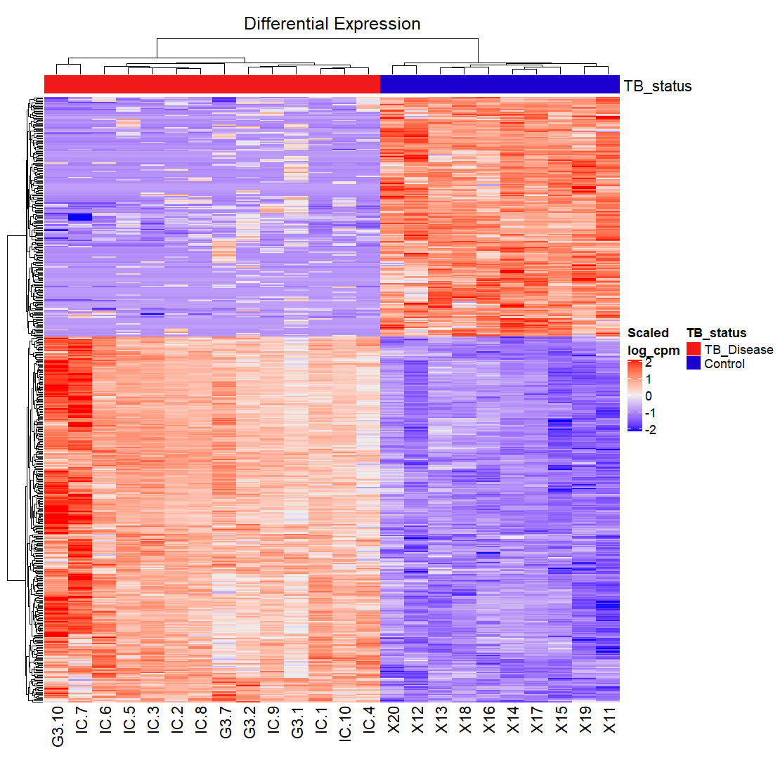
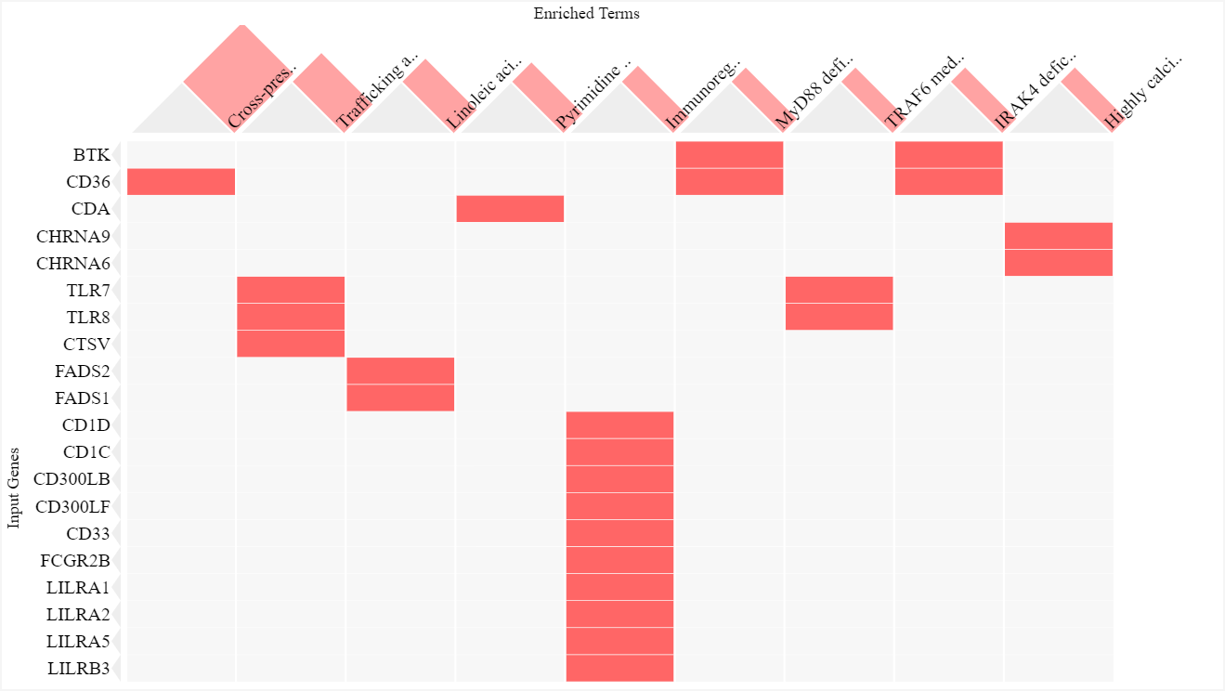
Control vs Disease

Slide 7
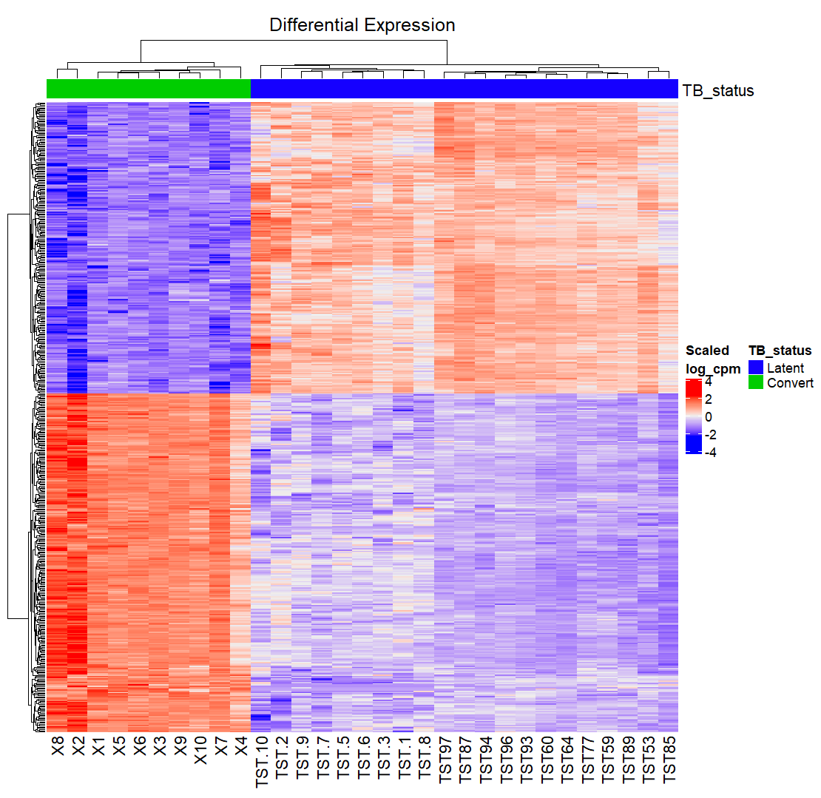
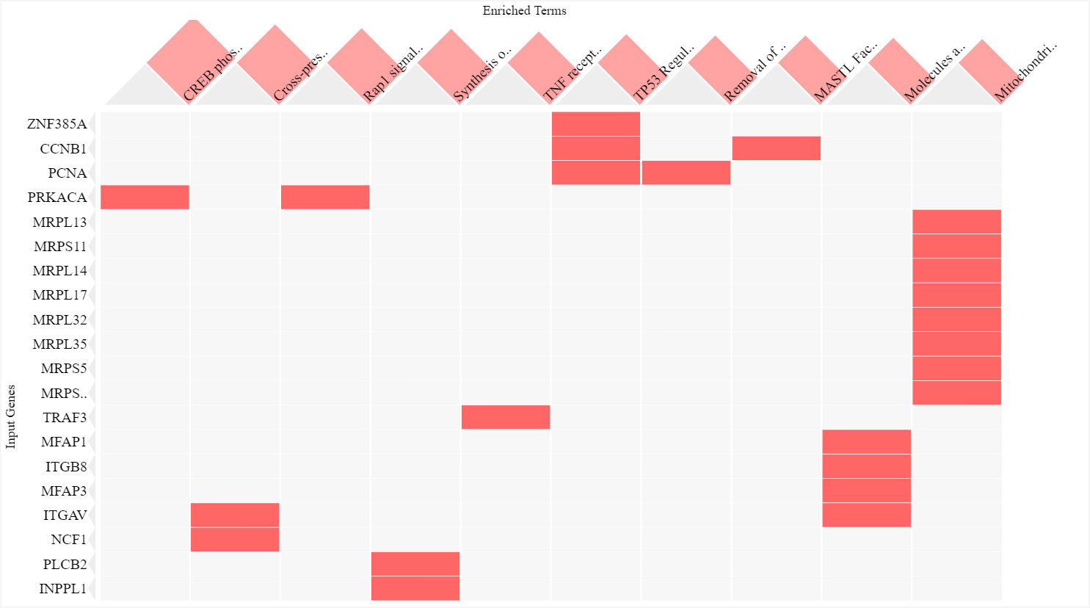
Convert vs Latent

Slide 8
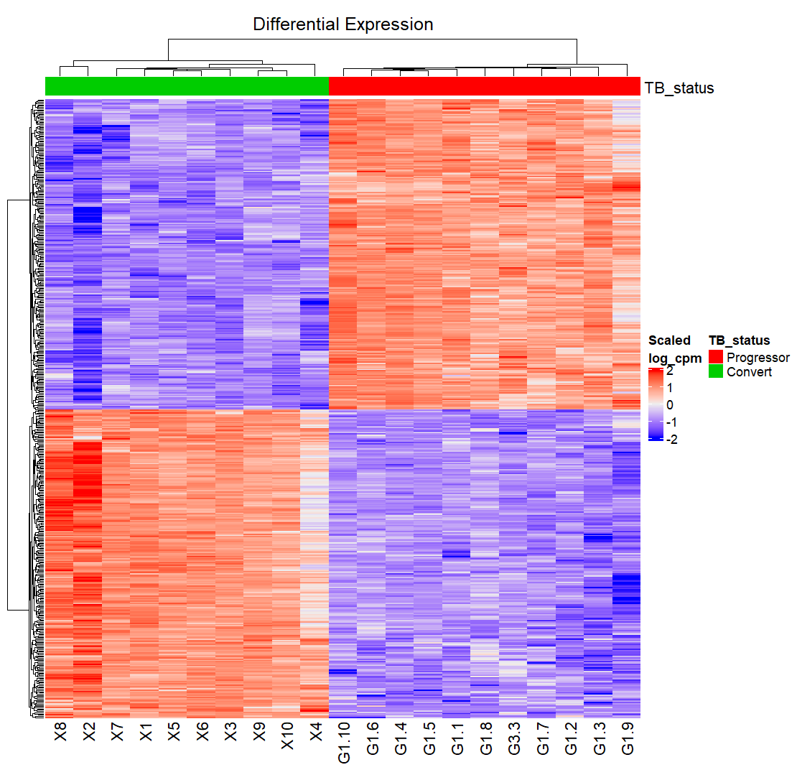
Converter vs Progressor

Slide 9
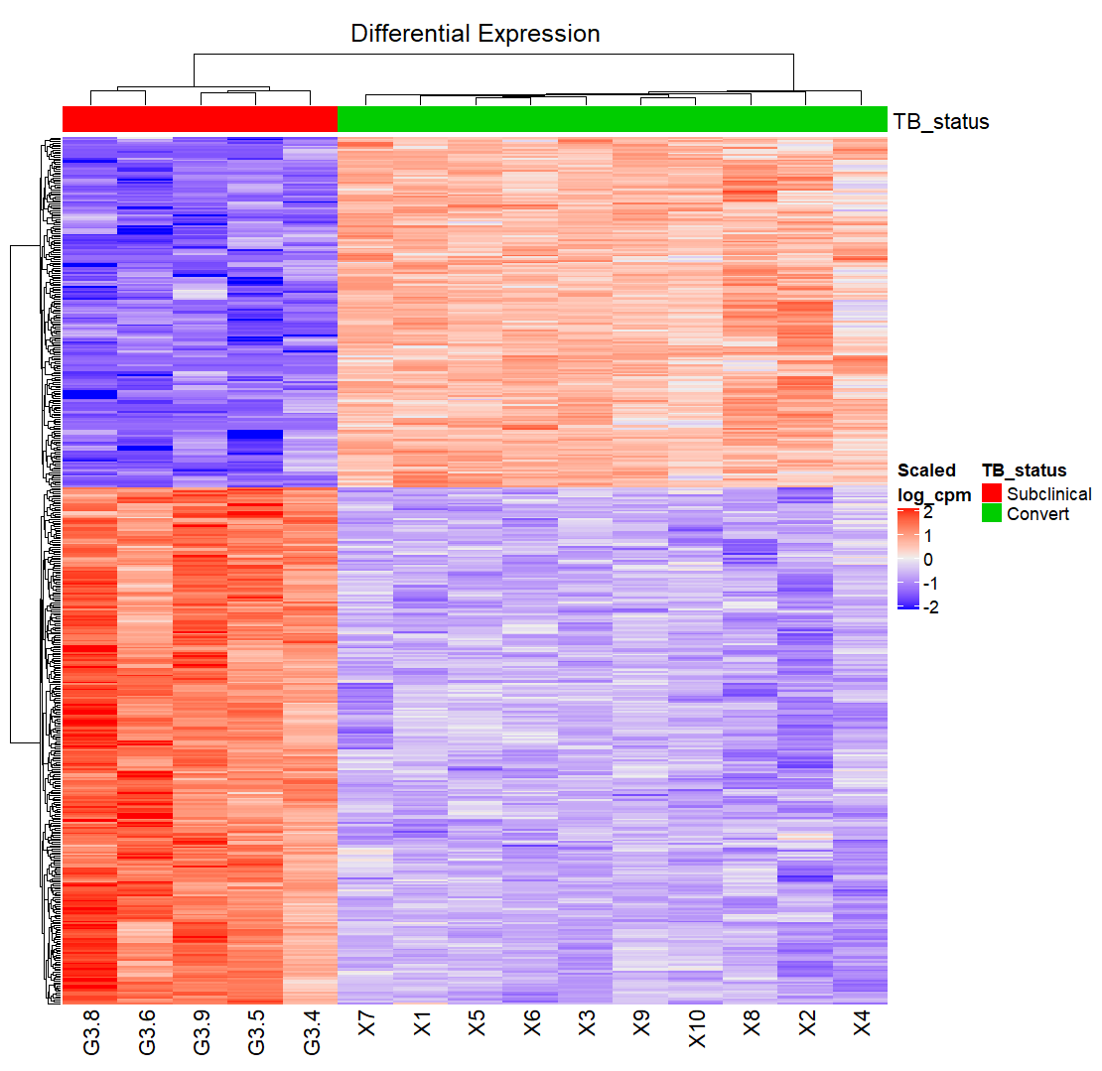
Converter vs Subclinical

Slide 10
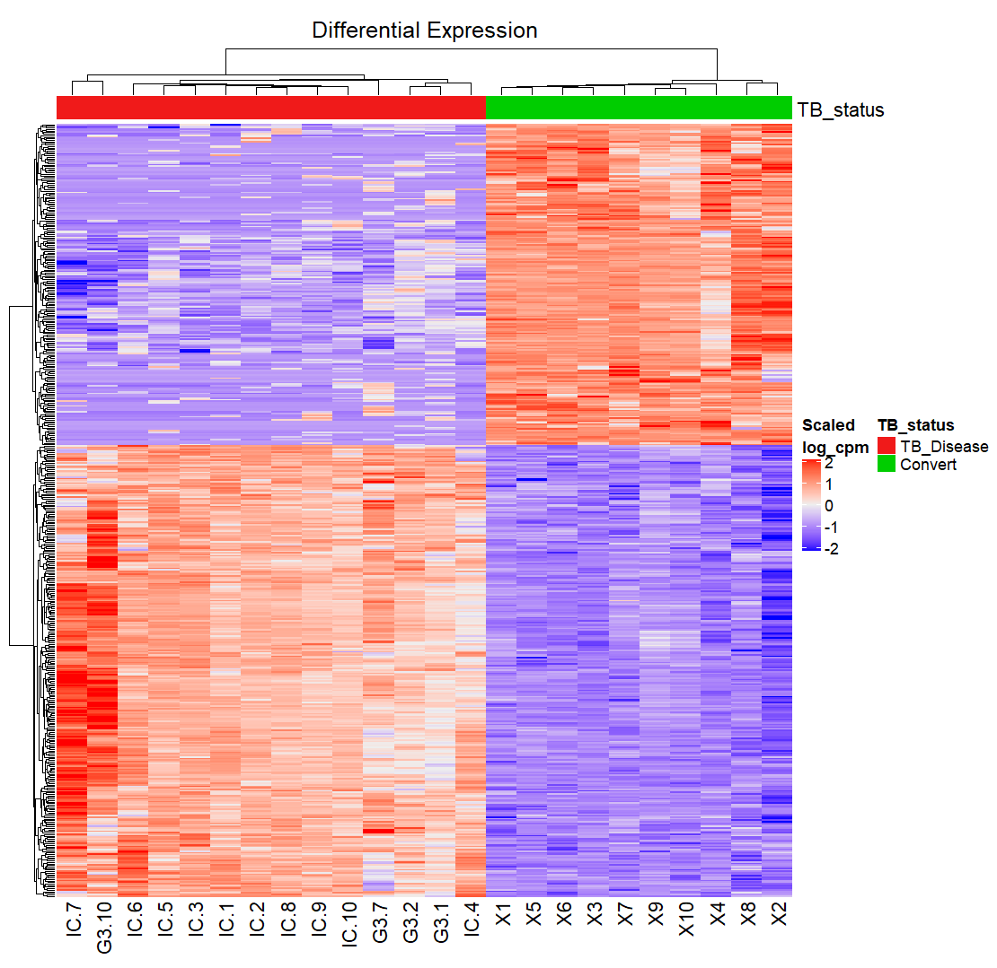
Converter vs TB_Disease

Slide 11
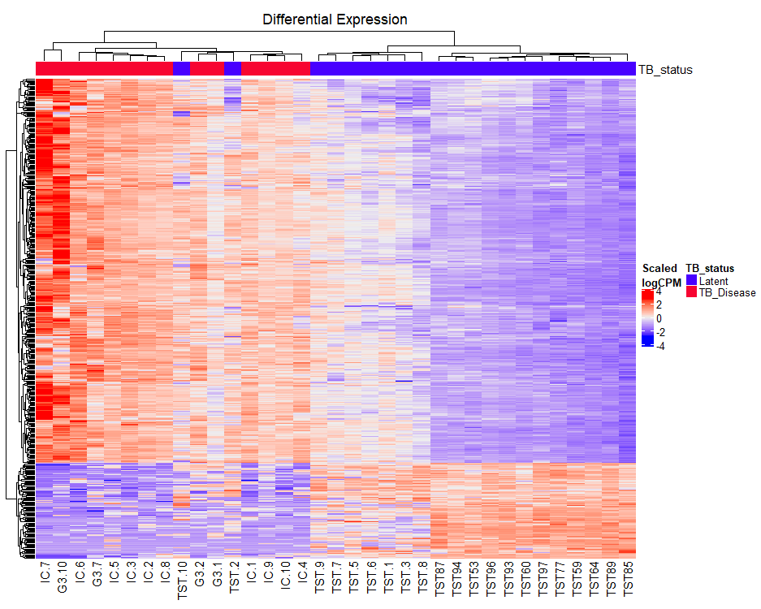
TB_Disease vs Latent

Slide 12
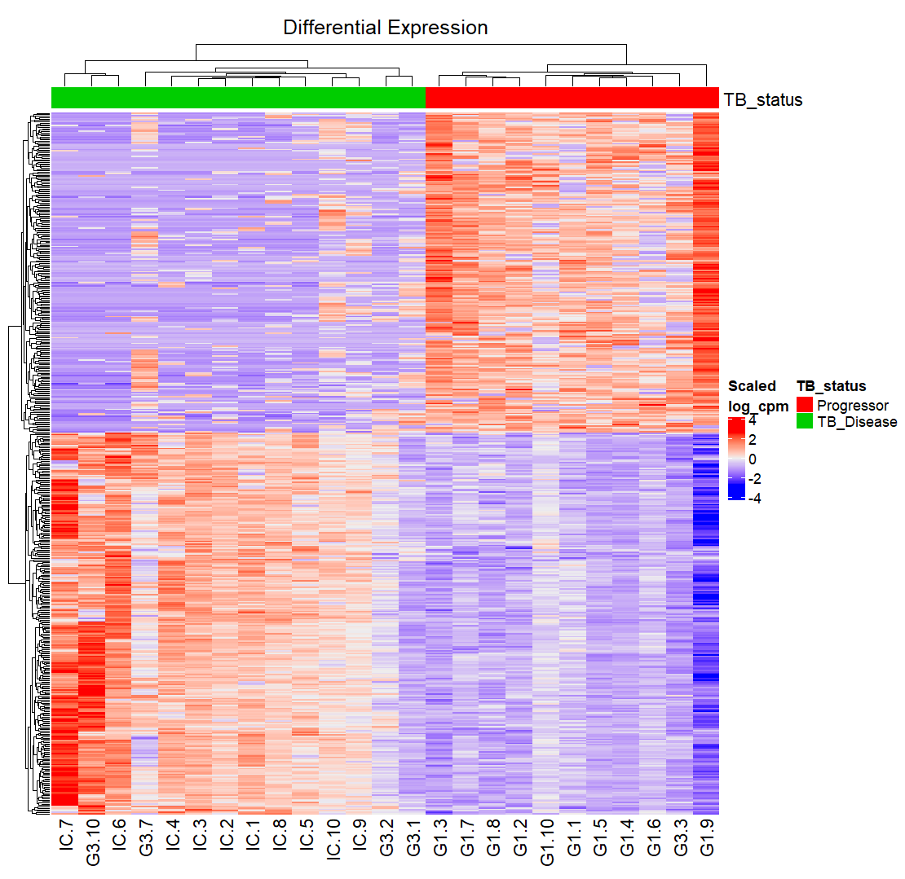
TB_Disease vs Progressor

Slide 13
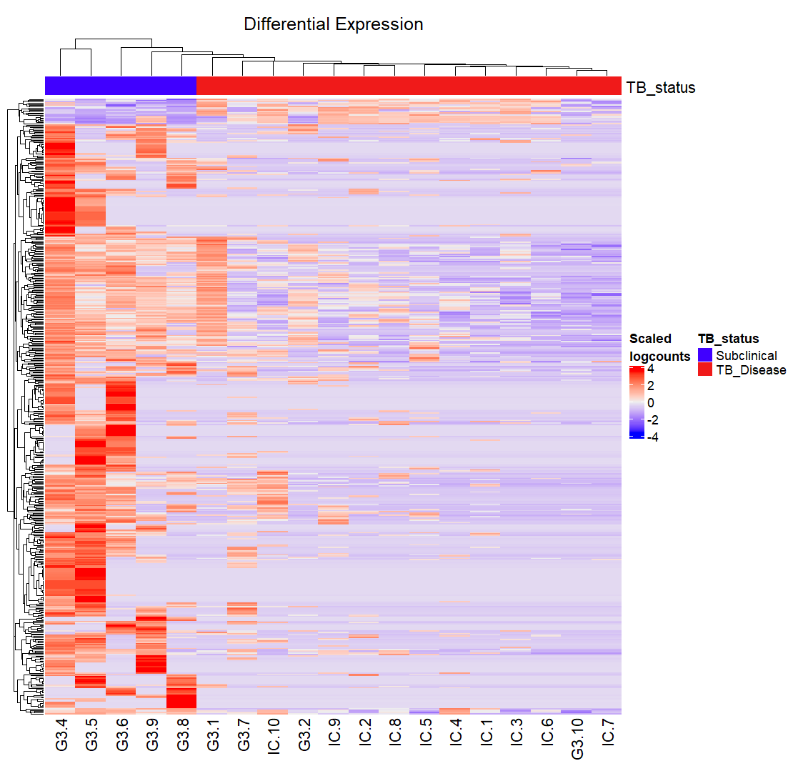
TB_Disease vs Subclinical

Slide 14
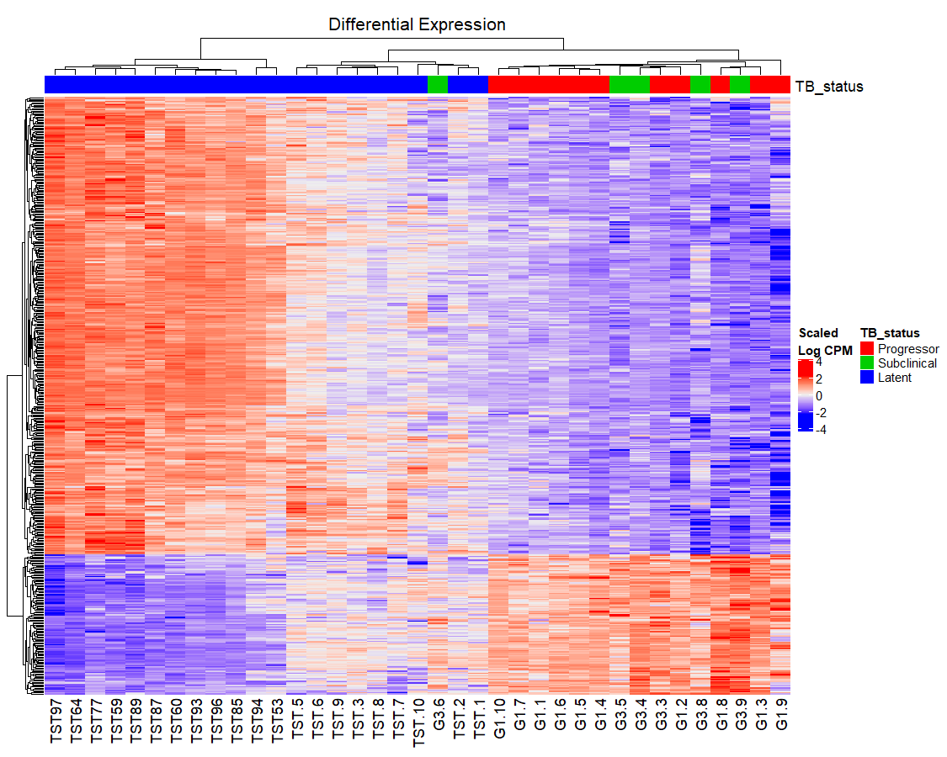
Latent vs Progressor

Slide 15
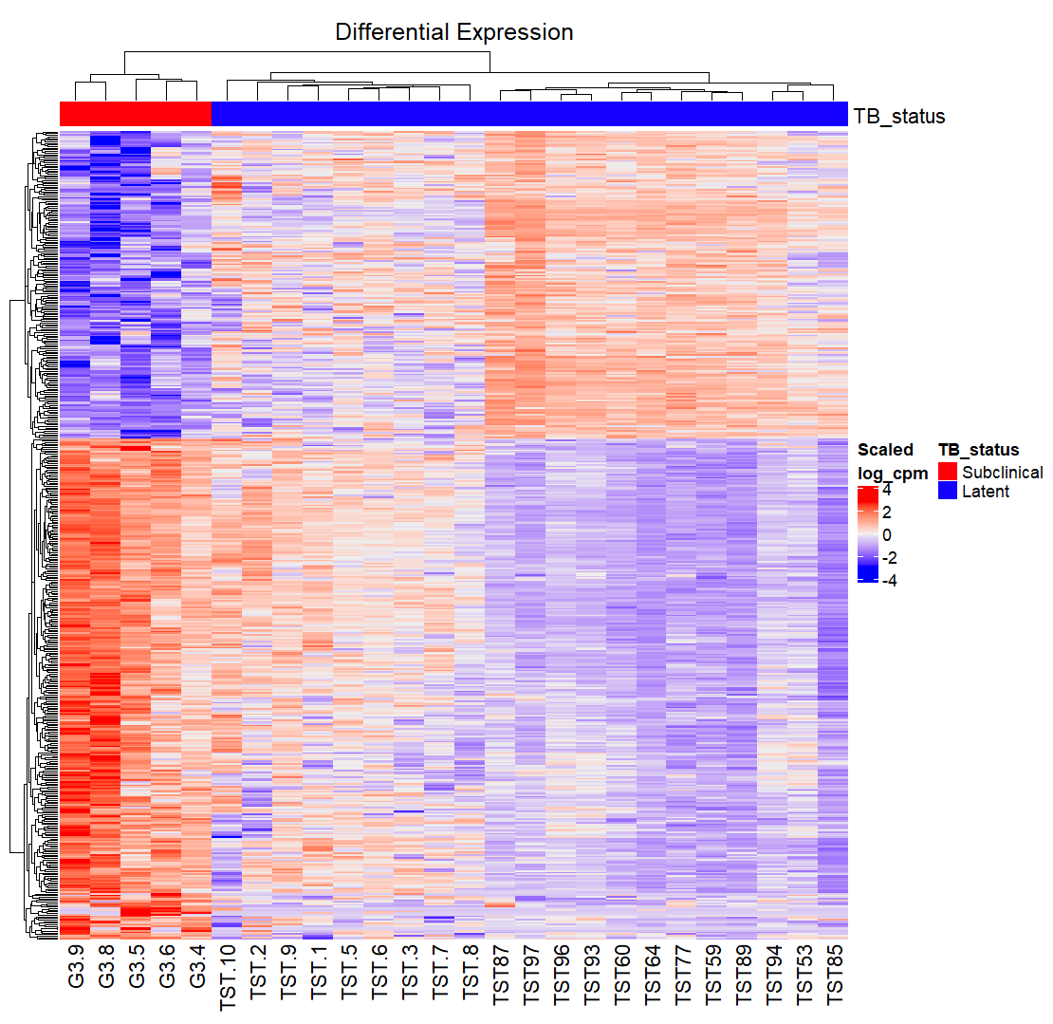
Latent vs Subclinical

Slide 16
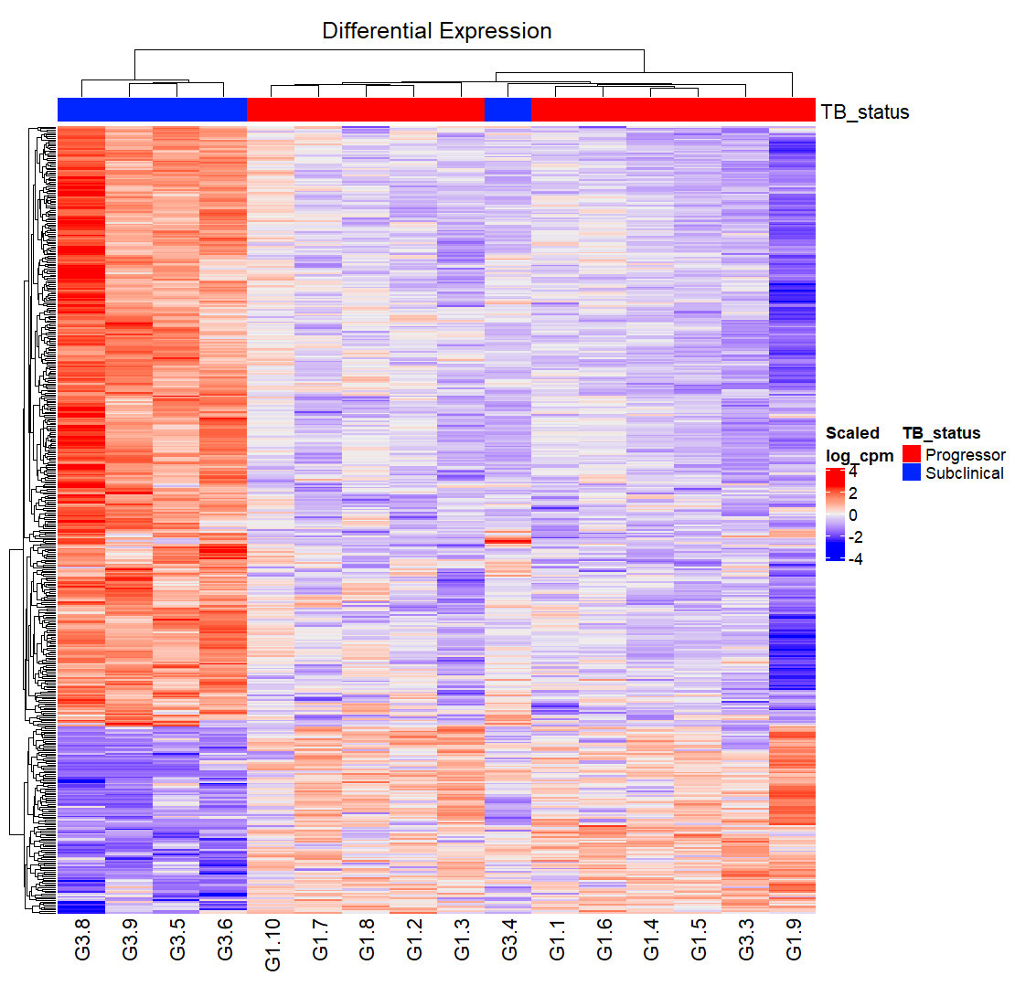
Progressor vs Subclinical

